Slide 1


Mechanics of Machines Dynamic Force Analysis Module 5: D’Alembert’s Principle, Dynamic Analysis of Planer Mechanism
Tapan Kumar Mahanta, Ph.D.
SMEC Chennai Campus

Slide 2
Dynamic Force Analysis:
Class Objective1: What is D’Alembert’s Principle ?
Class Objective2: Why D’Alembert’s Principle?
Class objective3: Dynamic Analysis of Planer Mechanism (Slider Crank Mechanism )

Slide 3





D’Alembert’s Principle :
D-Alembert’s principle states that the resultant force acting on a body together with the reversed effective force (or inertia force), are in equilibrium.
Inertial force is defined as the force which is in the opposite direction of the accelerating force and is equal to the product of the accelerating force and the mass of the body.
“The inertia force acts through the centre of the mass of the body”
Newton’s Second Law
Static system
Dynamic system
D’Alembert’s Principle

Slide 4
D’Alembert’s Principle :
D’Alembert’s principle, alternative form of Newton’s second law of motion.
The second law states that the force F acting on a body is equal to the product of the mass m and acceleration a of the body, or F = ma
D’Alembert’s form, the force F plus the negative of the mass m times acceleration a of the body is equal to zero: F - ma = 0.
In other words, the body is in equilibrium under the action of the real force F and the fictitious (pseudo) force -ma. The fictitious force is also called an inertial force and a reversed effective force.
D’Alembert’s principle reduces a problem in dynamics to a problem in statics.

Slide 5



Why D’Alembert’s Principle?
Because unknown forces are more easily determined on bodies in equilibrium than on moving bodies, the force and stress analysis of machine components can usually be simplified by using inertial forces.
Inertia force resists any change in velocity.
Inertia couple resists any change in the angular velocity.

Slide 6
Why Dynamic Analysis?
Dynamic forces are associated with accelerating masses.
All machines have some accelerating parts, dynamic forces are always present when machine operates.
Dynamic force leads to vibrations, wear, noise or even machine failure.

Slide 7




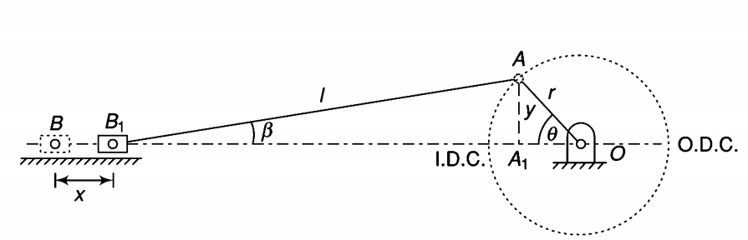
Dynamic Analysis of Slider crank mechanism
Where = length of the connecting rod
= length of the crank
= obliquity ratio
x = displacement of piston from I.D.C
θ = inclination of the crank to I.D.C
β = inclination of connecting rod to the line of stroke
= displacement of piston
= Velocity of piston
= Velocity of piston

Slide 8
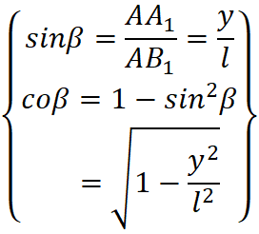


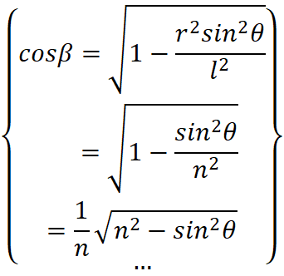

Dynamic Analysis of Slider crank mechanism (Displacement of piston)

Slide 9





Dynamic Analysis of Slider crank mechanism (Displacement of piston)
If connecting rod (l) is very large as compared to the crank (r), ,

Slide 10






Dynamic Analysis of Slider crank mechanism (Velocity of piston)
If n² is large compared to sinθ
when n is very large, can be neglected

Slide 11





Dynamic Analysis of Slider crank mechanism (Acceleration of piston)

Slide 12






Dynamic Analysis of Slider crank mechanism (Acceleration of piston)
when θ=0⁰ (at I.D.C) and n is very very high
when θ=180⁰ (at O.D.C) and n is very very high
Motion direction reversed
when n is very very large

Slide 13




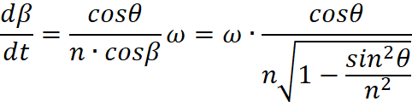



Dynamic Analysis of Slider crank mechanism (Angular velocity of connecting rod)
From the left figure we can write
Differentiating with respect to ‘t’

Slide 14






Dynamic Analysis of Slider crank mechanism (Angular acceleration of connecting rod)
Differentiating with respect to ‘t’

Slide 15
Problem 1:
The crank and connecting rod of a steam engine are 0.3 m and 1.5 m in length. The crank rotates at 180 r.p.m. clockwise.
(i) Determine the velocity and acceleration of the piston when the crank is at 40 degrees from the inner dead centre position.
(ii) Also determine the position of the crank for zero acceleration of the piston.

Slide 16
Problem 2:
In a slider crank mechanism, the length of the crank and connecting rod are 150 mm and 600 mm respectively. The crank position is 60°from inner dead centre. The crank shaft speed is 450 r.p.m. (clockwise). Using analytical method, determine:
(i)Velocity and acceleration of the slider.
(ii) Angular velocity and angular acceleration of the connecting rod.

Slide 17
Problem 3:
In a slider crank mechanism the stroke of the slider is 200 mm and the obliquity ratio is 4.5. The crank rotates uniformly at 400 rpm clockwise. While the crank is approaching the inner dead center and the connecting rod is normally to the crank. Find
(i) Velocity of piston and angular velocity of the C.R.
(ii) Acceleration of the piston and angular acceleration of the C.R.

Slide 18

Problem 4:
In an I.C engine mechanism having obliquity ratio n, show that for uniform engine speed the ratio for piston acceleration at the beginning of stroke and end of the stroke is given by

Slide 19
Problem 4:
In an I.C engine mechanism having obliquity ratio n, show that for uniform engine speed the ratio for piston acceleration at the beginning of stroke and end of the stroke is given by

Slide 20
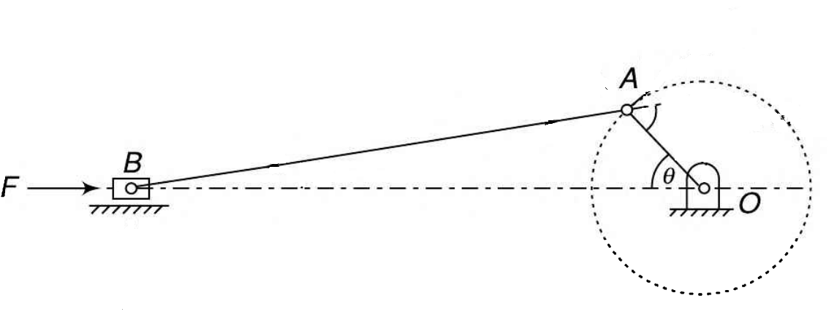



Engine force Analysis:
Piston effort (F) (Effective driving force)
Piston effort is termed as the net or effective force applied on the piston.
Reciprocating masses accelerate during the first half (Inertia force tends to resist), thus net force on the piston decreased.
Later half reciprocating masses decelerate ( inertia force opposes in direction of applied gas pressure), thus effective force increased.
Let A₁ =area of the cover end
P₁ =pressure on the cover end
P₂ =pressure on the rod end
A₂ =area of the rod end
m = mass of the reciprocating parts
Force on the piston due to gas pressure,

Slide 21







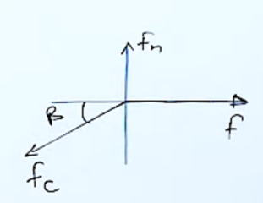

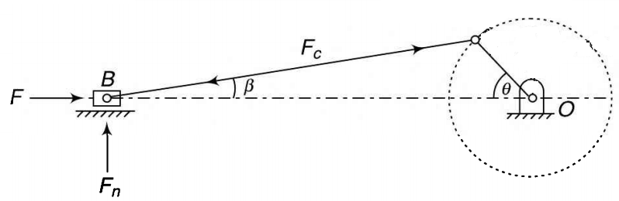
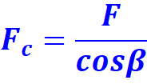
Engine force Analysis:
Piston effort (F) (Effective driving force) continued
Inertia force,
Friction resistance,
Force on the piston for horizontal Engine:
Force on the piston for vertical Engine:
Force along the connecting rod ( )

Slide 22




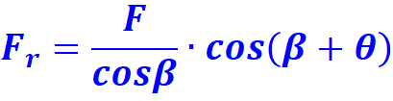
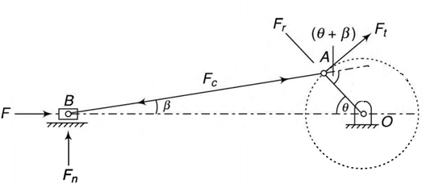


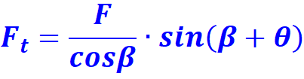
Engine force Analysis:
Thrust on the cylinder wall ( )
Radial force on the crank ( ) or thrust on the crank shaft bearing
Tangential force or crank effort ( )

Slide 23

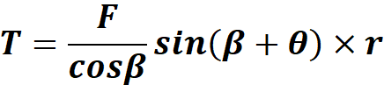
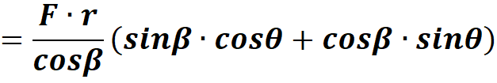
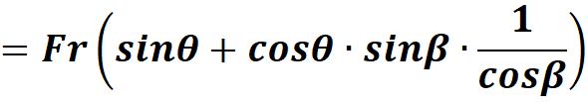
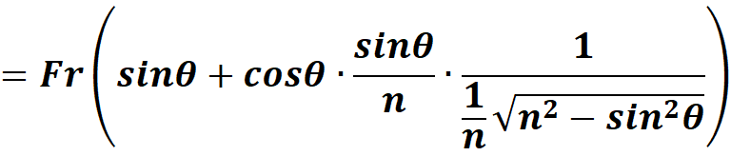
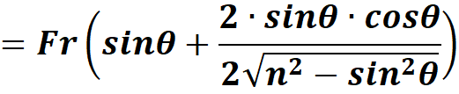
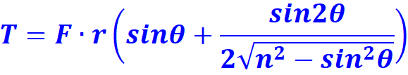
Turning moment on crankshaft:
Turning moment on crank shaft (T)

Slide 24
Problem 5:
The crank and connecting rod of a vertical steam engine, running at 1800 rpm are 60mm and 270mm respectively. The diameter of the piston is 100mm and the mass of the reciprocating parts is 1.2kg. During the expansion stroke when the crank has turned 20⁰ from the TDC, the gas pressure is 650 kN/m². Determine
(i) net force on the piston
(ii) net load on the gudgeon pin
(iii) thrust on the cylinder walls
(iv) speed at which the gudgeon pin load is reversed in direction

Slide 25
Problem 6:
In a vertical double acting steam engine, the connecting rod is 4.5 times the crank.The weight of the reciprocating parts is 120 kg and the stroke of the piston is 440mm. The engine runs at 250 rpm. If the net load on the piston due to steam pressure is 25 kN when the crank has turned through an angle of 120⁰ from the TDC.Determine
(i) Thrust on the connecting rod
(ii) pressure on the slide bar
(iii) tangential force on the crank pin
(iv) thrust on the bearing
(v) turning moment on the crank shaft

